Slide 1
JavaScript Juggernauts
Lesson 3.3

Slide 2
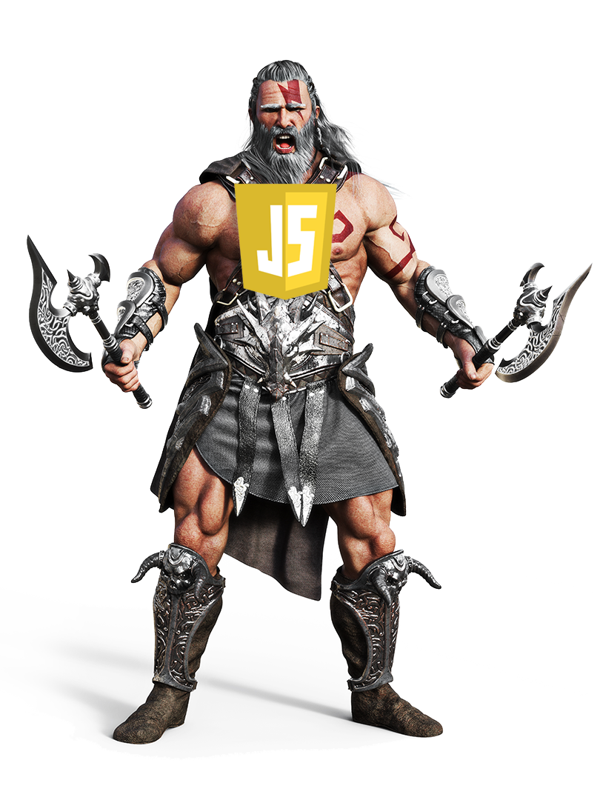
This Will Soon Be You
JavaScript Juggernauts
JavaScript Juggernauts
Notes:
Image is from: shutterstock_1037716798

Slide 3
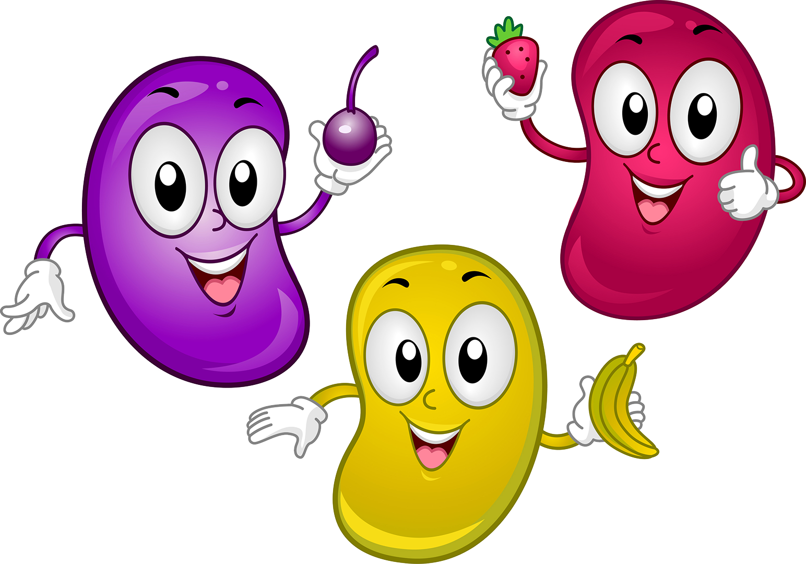
But Right Now You Feel Like
JavaScript Jellybeans
JavaScript Juggernauts
Notes:
Image is from: shutterstock_97065224

Slide 4
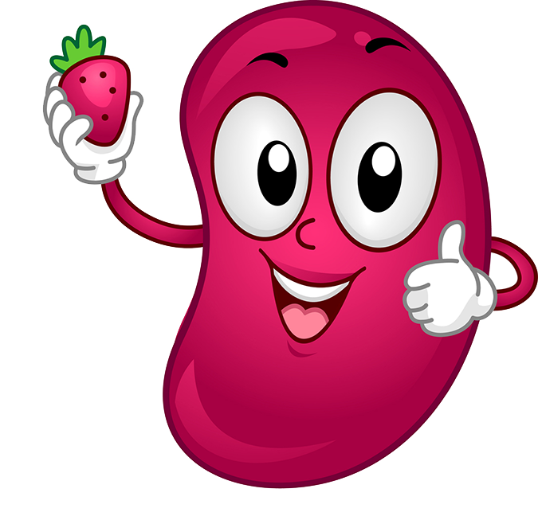
Transformation to Come!
HANG IN THERE!
JavaScript Juggernauts

Slide 5
Today’s Class
JavaScript Juggernauts

Slide 6

Objectives
In today’s class, we’ll cover:
JavaScript Functions
JavaScript Objects
Building Simple JavaScript Applications
JavaScript Juggernauts

Slide 7
JavaScript Functions
JavaScript Juggernauts

Slide 8
Logging: No Functions
JavaScript Juggernauts

Slide 9
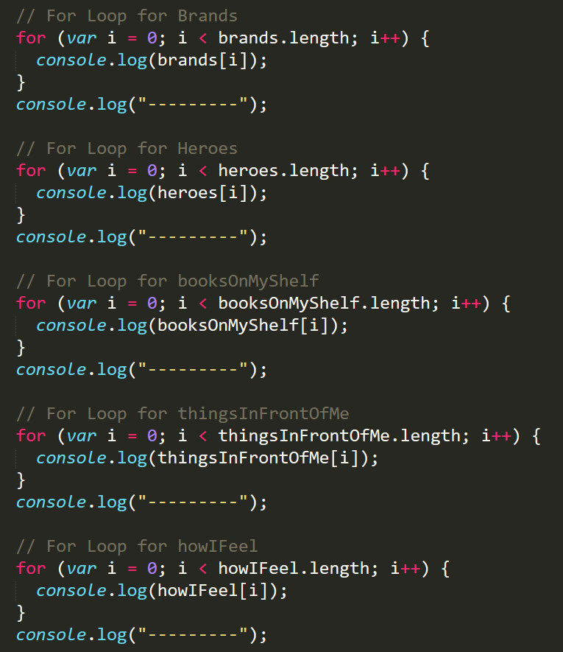


Mondo Repetitive
Who wants to maintain this?
Hint: No one.
JavaScript Juggernauts

Slide 10
Logging: With Functions
JavaScript Juggernauts

Slide 11
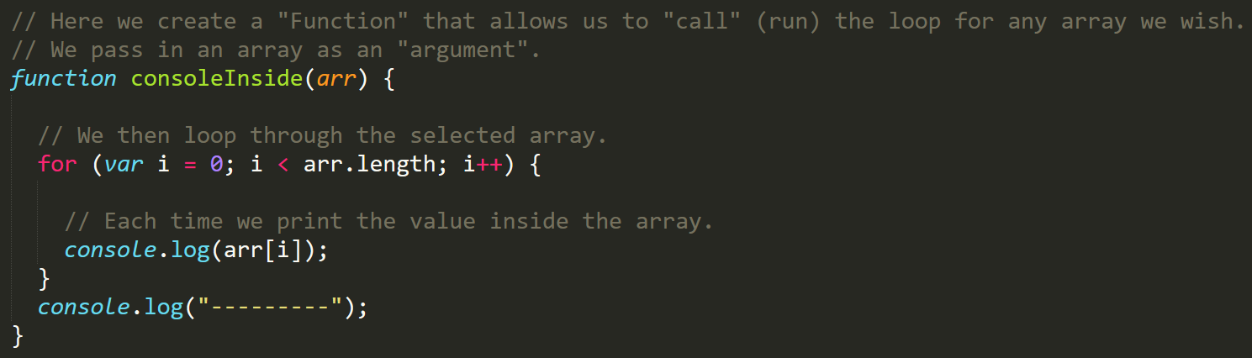
Much Better with Functions!
Squeaky clean code. Minimal repetition.
JavaScript Juggernauts

Slide 12
20 minutes
Partner Activity: My First Functions
JavaScript Juggernauts

Slide 13

Partner Activity: My First Functions
Suggested Time: 20 minutes
Working in pairs and using the starter file sent to you via Slack, fill in the missing functions and function calls.
Note: Try to finish all four functions if you can, but don’t be distressed if you only get 1 or 2. The important thing is that you get at least one function fully done.
HINT: Look back to the previous example if you need help.
JavaScript Juggernauts

Slide 14
JavaScript Objects
JavaScript Juggernauts

Slide 15
Good Arrays
JavaScript Juggernauts

Slide 16
Joan of Arc (Bad Arrays)
JavaScript Juggernauts

Slide 17
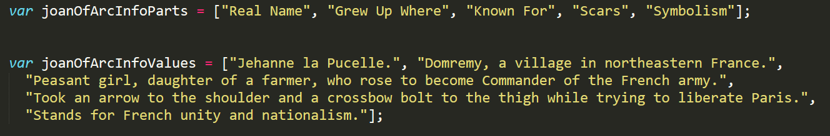
Associated Data ==/== Arrays
Relating two separate arrays is not fun.
JavaScript Juggernauts

Slide 18
Gandalf the Grey Objects
JavaScript Juggernauts

Slide 19
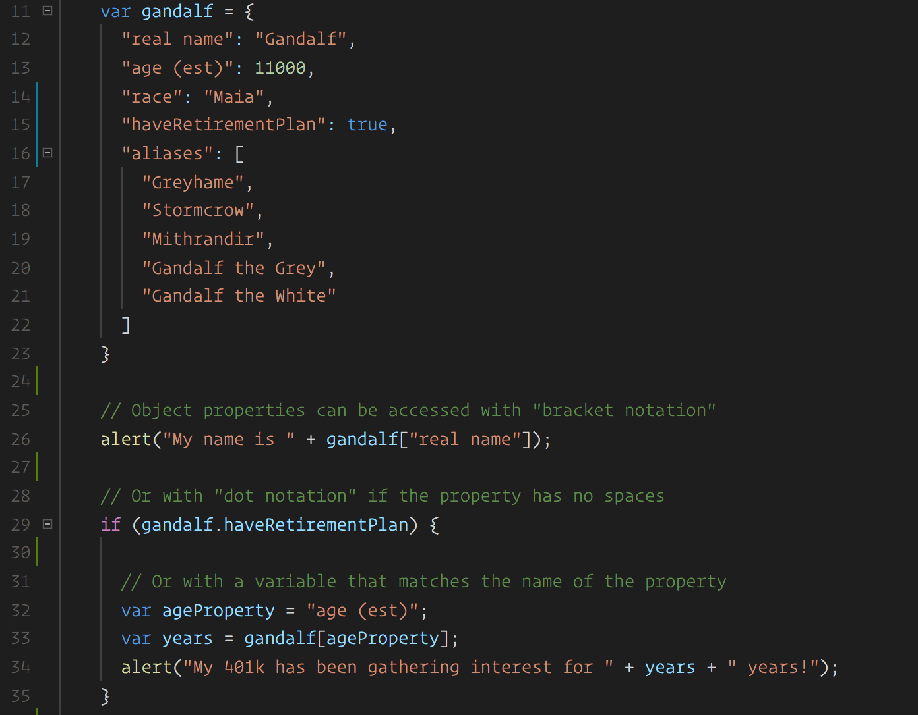
Gandalf: The Object
Gandalf’s properties and values are associated in object form, making it easy to recall specific data.
JavaScript Juggernauts

Slide 20

Objects Visualized
This is Gandalf. According to code, Gandalf is an object.
var gandalf | = | {
“real name” | : | “Gandalf” | ,
“age (est)” | : | 11000 | ,
“race” | : | “Maia”
}
JavaScript Juggernauts
Notes:
Image is from: shutterstock_1018526638

Slide 21
Objects Visualized
These are Gandalf’s properties (like descriptors).
var gandalf | = | {
“real name” | : | “Gandalf” | ,
“age (est)” | : | 11000 | ,
“race” | : | “Maia”
}
JavaScript Juggernauts
Notes:
Image is from: shutterstock_1018526638

Slide 22
Objects Visualized
These are the values of Gandalf’s properties.
var gandalf | = | {
“real name” | : | “Gandalf” | ,
“age (est)” | : | 11000 | ,
“race” | : | “Maia”
}
JavaScript Juggernauts
Notes:
Image is from: shutterstock_1018526638

Slide 23
Objects Visualized
Thus: gandalf[“race”] = “Maia
var gandalf | = | {
“real name” | : | “Gandalf” | ,
“age (est)” | : | 11000 | ,
“race” | : | “Maia”
}
JavaScript Juggernauts
Notes:
Image is from: shutterstock_1018526638

Slide 24
Gandalf: The Grey Objects (Repeat)
JavaScript Juggernauts

Slide 25
15 minutes
Group Activity (2 people): Basic Objects
JavaScript Juggernauts

Slide 26
Group Activity: Basic Objects
Suggested Time: 15 minutes
With a partner, spend the next few moments studying the code just slacked to you.
Then, write code below each comment to log the relevant information about the provided car object.
Bonus: If you finish early, create a brand new object of your own. Slack out a snippet of the code to the class when you are done. Be Creative!
JavaScript Juggernauts

Slide 28
Run That Car!
JavaScript Juggernauts

Slide 29
15 minutes
Challenge: Run That Car!
JavaScript Juggernauts

Slide 30
Challenge: Run That Car!
Suggested Time: 15 minutes
Using the code from the previous activity as a starting point, create a complete application such that:
Users can enter keyboard input (letters).
Each of the car's methods are assigned to a key.
When the user presses a key, it calls the appropriate function.
These letters also trigger a global function called rewriteStats() that logs the car's make, model, color, mileage, and isWorking status to the console.

Slide 31
Questions?
JavaScript Juggernauts

